Slide 1
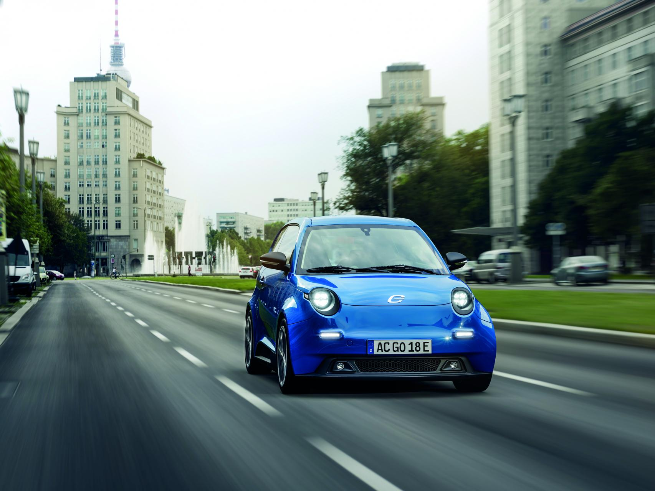
e.GO Parking Buddy Simplify the hassle of parking
Team Krautcoding

Slide 2
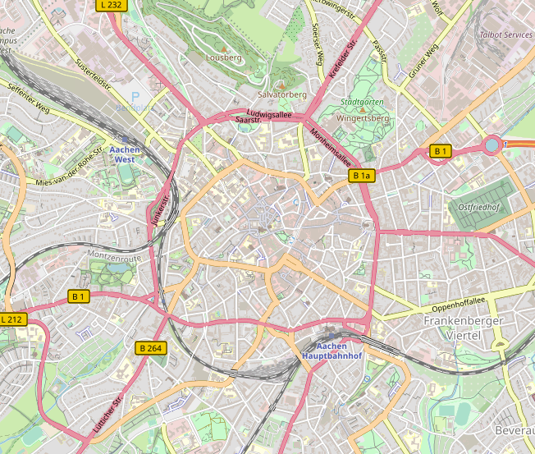
eGO solution - Mobility Hubs
Great solution for people coming medium haul ways that have enough time to switch vehicles
But does it really fit all of your daily routes?
What about all those times you have a trunk full of stuff you need?

Slide 3
How much time do YOU spend parking?

Slide 4
How much time do YOU spend parking?

Slide 5
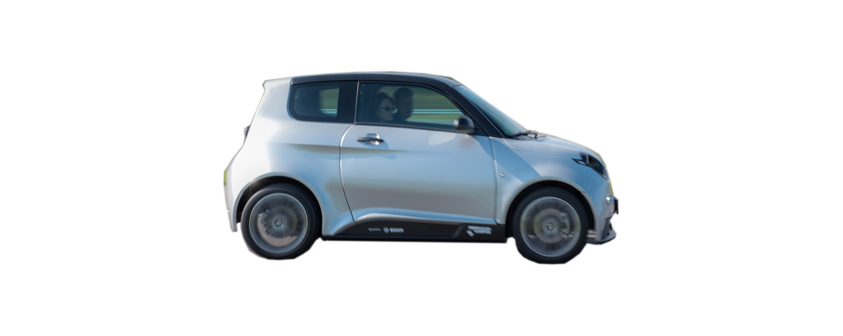

Away from destination
No charging port
Karl
30min
☐ Overfull on- and off-street parking
☐ Providing sufficient charging ports is highly challenging
☐ Major parts of traffic volume are caused by people searching for free spots
Issues

Slide 6
Away from destination
No charging port
Karl
30min
100% covenient
eGO is safe
eGO is charged
15min

Slide 7
Our Idea
eGO Moover as mobile Parking spot
Autonomous transport to Mobility Hub
Drasticly simplifing coming home

Slide 8
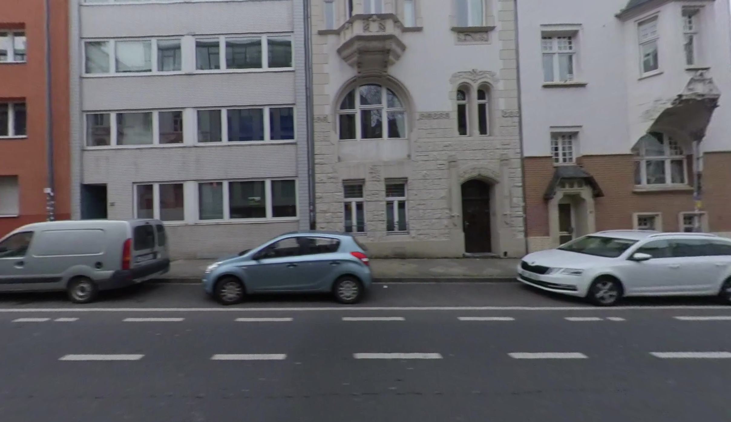
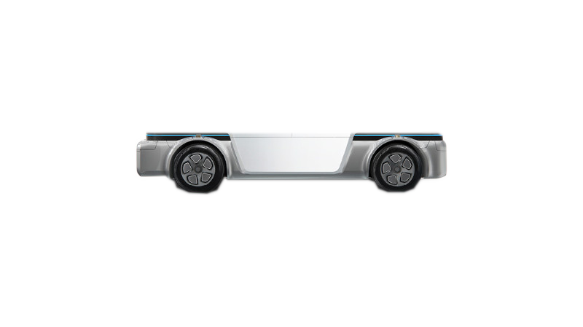
How does is work physically?

Slide 9
What‘s your benefit?
Your car is safely parked
Your car is always fully charged
Use individual mobility as it‘s meant to be. Even in big cities.

Slide 10
What‘s eGO‘s benefit?
Providing the charging infrastructure
Standalone in the market
Gaining access to customers who drive regular cars

Slide 11



Technology Stack
Control Center
Webapp
e.PI Parking Buddy AOI
Google Maps API

Slide 12
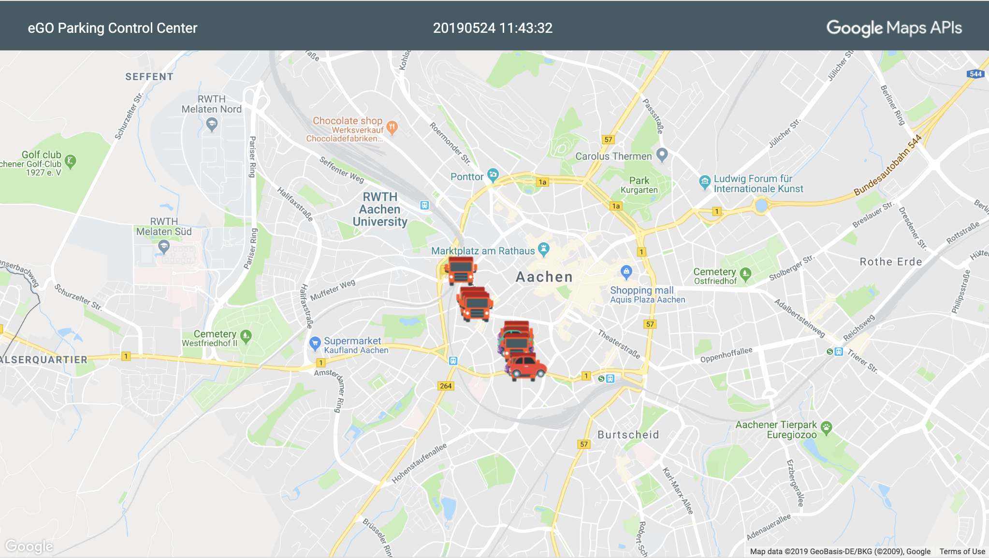
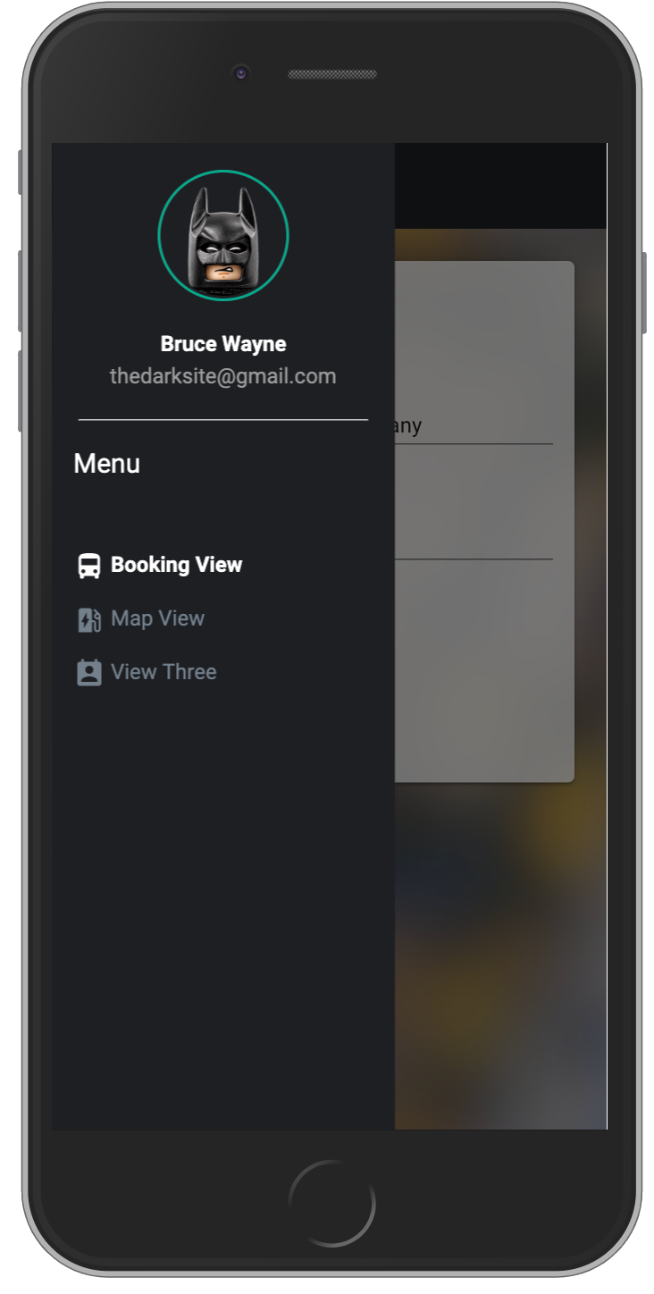
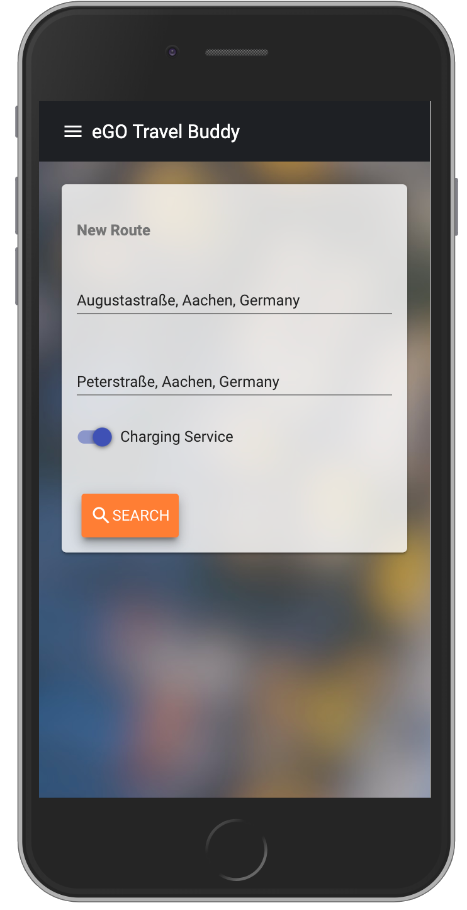
Webapp & Control Center
Feels just like a native iOS/Android app

Slide 13
What‘s next?
Returning cars to desired location
Use of API to find need for vehicle maintenance with shuttle to eGO workshop

Slide 14

Live Demo

